Slide 1
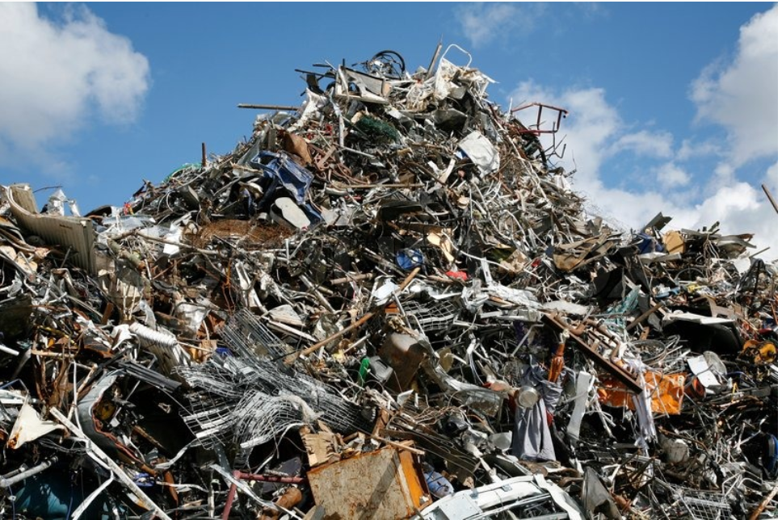
What is Non-Prod Data Looks Like

Slide 2

Story Representing Non-Prod
How many Crow are in Delhi? Or How many Issues in O2 Jira Service Desk?

Slide 3
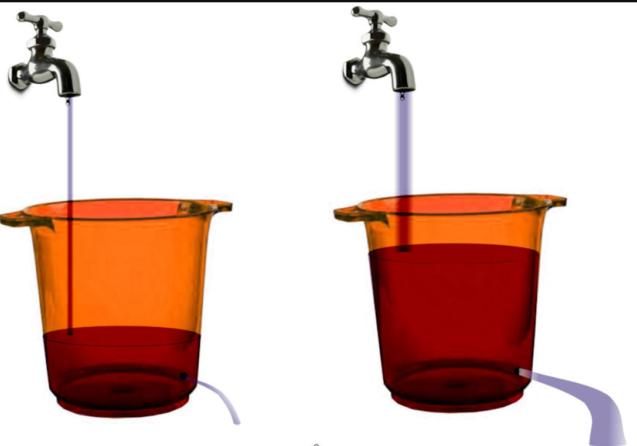
Issues We saw in Non-Prod
Non-prod Issues
Prod Issues

Slide 4
Issues We saw in Non-Prod
EMAIL With No details

Slide 5
Issues We saw in Non-Prod
Email With Lot of details

Slide 6
Issues We saw in Non-Prod
Sample Issues coming from Dev region

Slide 7

Before Started Non-prod Supporter

Slide 8







Starting Analysis Of Non-Prod
Error Logged
Alert is raised to service desk
Ticket is created
Manual intervention need here after

Slide 9

Starting Analysis Of Non-Prod
Current data is Misleading , incomplete and out right wrong some times

Slide 10

Started Analysis Of Non-Prod

Slide 11

Started Analysis Of Non-Prod (After spending some time in Non-prod support)

Slide 12
Present Analysis Of Non-Prod (Month-Nov)
Sr.no | Label | Count
1 | Total Number of Issue | 8587
2 | Total Number of pattern | 32
3 | Solved | 7
4 | Assigned | 7
5 | Team Identified | 2
6 | Need more investigation | 11
7 | Misleading , incomplete | 5

Slide 13
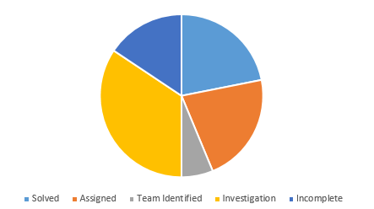
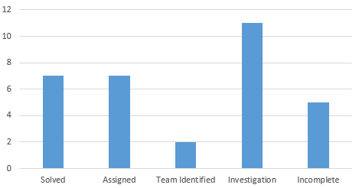
Present Analysis Of Non-Prod (Issue Status)
https://confluence.schwab.com/display/EXPRESS/Non-Prod+Issues

Slide 14
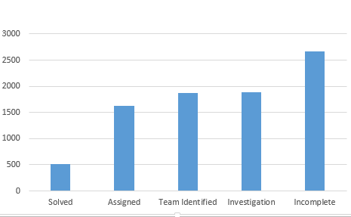
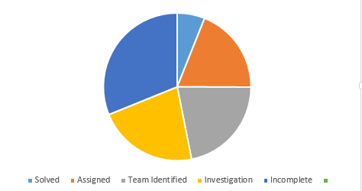
Present Analysis Of Non-Prod (Number based on Status)
https://confluence.schwab.com/display/EXPRESS/Non-Prod+Issues

Slide 15

Present Analysis Of Non-Prod (Breakdown of Graph)

Slide 16
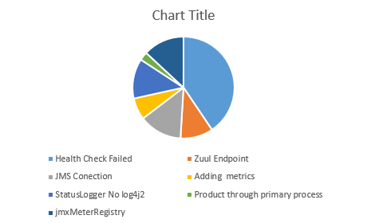
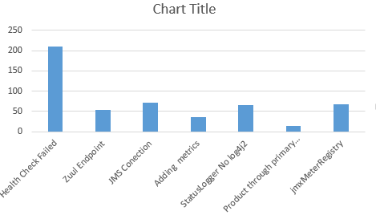
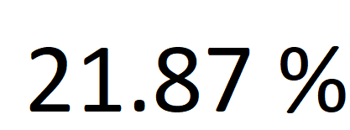
Present Analysis Of Non-Prod (Resolved break Down)
https://confluence.schwab.com/pages/viewpage.action?pageId=463178925

Slide 17
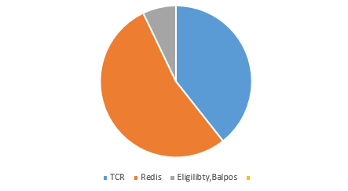
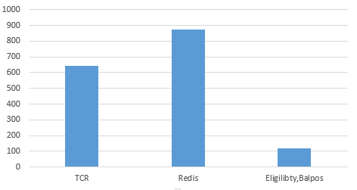
Present Analysis Of Non-Prod (Assigned Data)
https://confluence.schwab.com/pages/viewpage.action?pageId=463178949

Slide 18
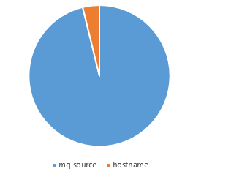
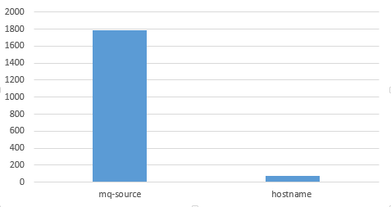

Present Analysis Of Non-Prod (Team Identified Data)
https://confluence.schwab.com/pages/viewpage.action?pageId=463178974

Slide 19
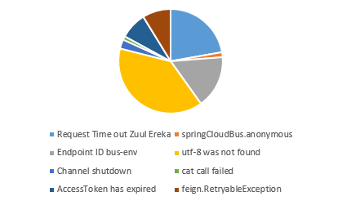
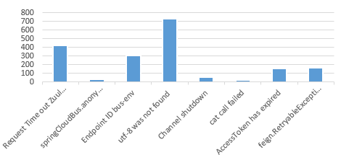
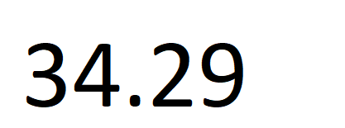
Present Analysis Of Non-Prod (Investigation Data)
https://confluence.schwab.com/pages/viewpage.action?pageId=463179287

Slide 20
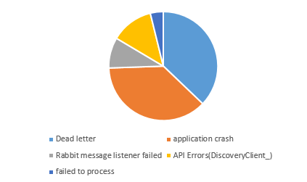
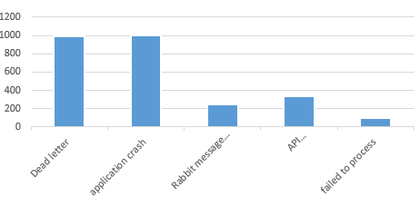
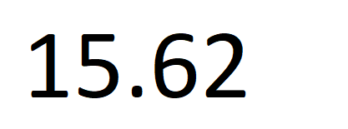
Present Analysis Of Non-Prod (Incomplete, Misleading Data)
https://confluence.schwab.com/pages/viewpage.action?pageId=463179322

Slide 21

What Will happened non-prod continued

Slide 22

Solutions

Slide 23

Options

Slide 24
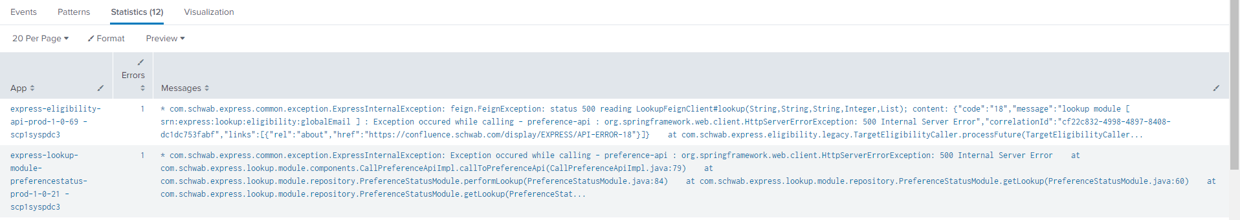
Tech Solution For Non-Prod Issue (Splunk Report)
Having Splunk Report/ mail of daily failing application with Following detail , Application name Error Details Aggregated with number of times it occurred

Slide 25

Tech Solution For Non-Prod Issue
Error Logged
Alert is raised to service desk
Ticket is created
Adding Spring Task

Slide 26

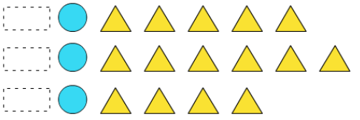
Process Solution For Non-Prod Issue
Error Logged
Alert is raised to service desk
Come With Solution / detail Analysis
Identify recurring Pattern in issues
Ticket is created
Next Slide

Slide 27


Create Jira in Express Backlog with details of Analysis or solution of it
In Service desk Mark Jira as duplicate with Express Jira number for tracking

Slide 28

Ignoring is not Solution

Slide 29
Ignoring is not Solution
Sr.no | Region | Issues
1 | Non prod | 8587
2 | Prod | 2452

Slide 30
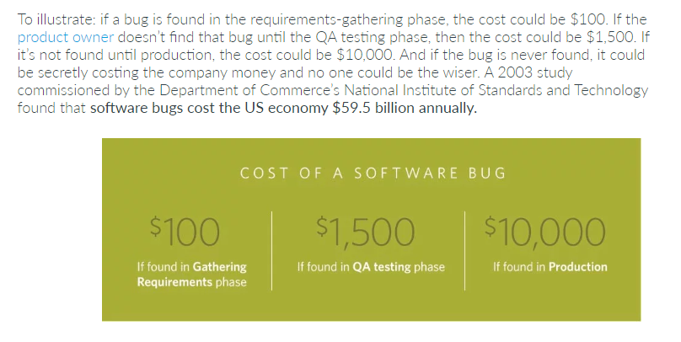
Ignoring Cost
https://www.celerity.com/the-true-cost-of-a-software-bug

Slide 31
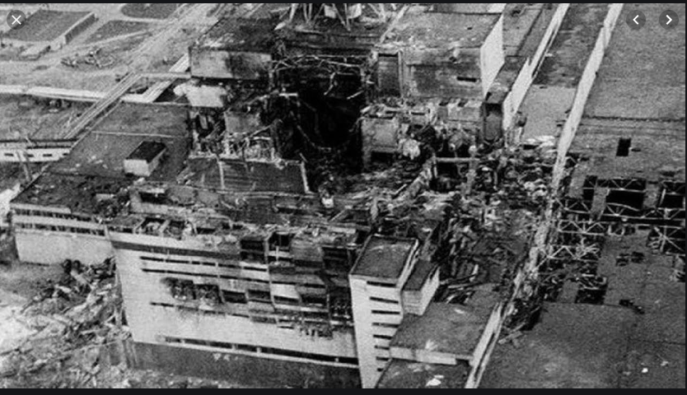
Ignoring is not Solution
Ignoring smaller issue lead to bigger issues (Chernobyl)

Slide 32

Life if Continued in non-prod Support
Sample email for Incomplete message
Propsed Options
Process flow
Dev issue details

Slide 33

Thank you

